Slide 1
Field-Bounded Crop Classification
ADMN 5016
Machine Learning Project
Donovan Bangs
April 13, 2022

Slide 2
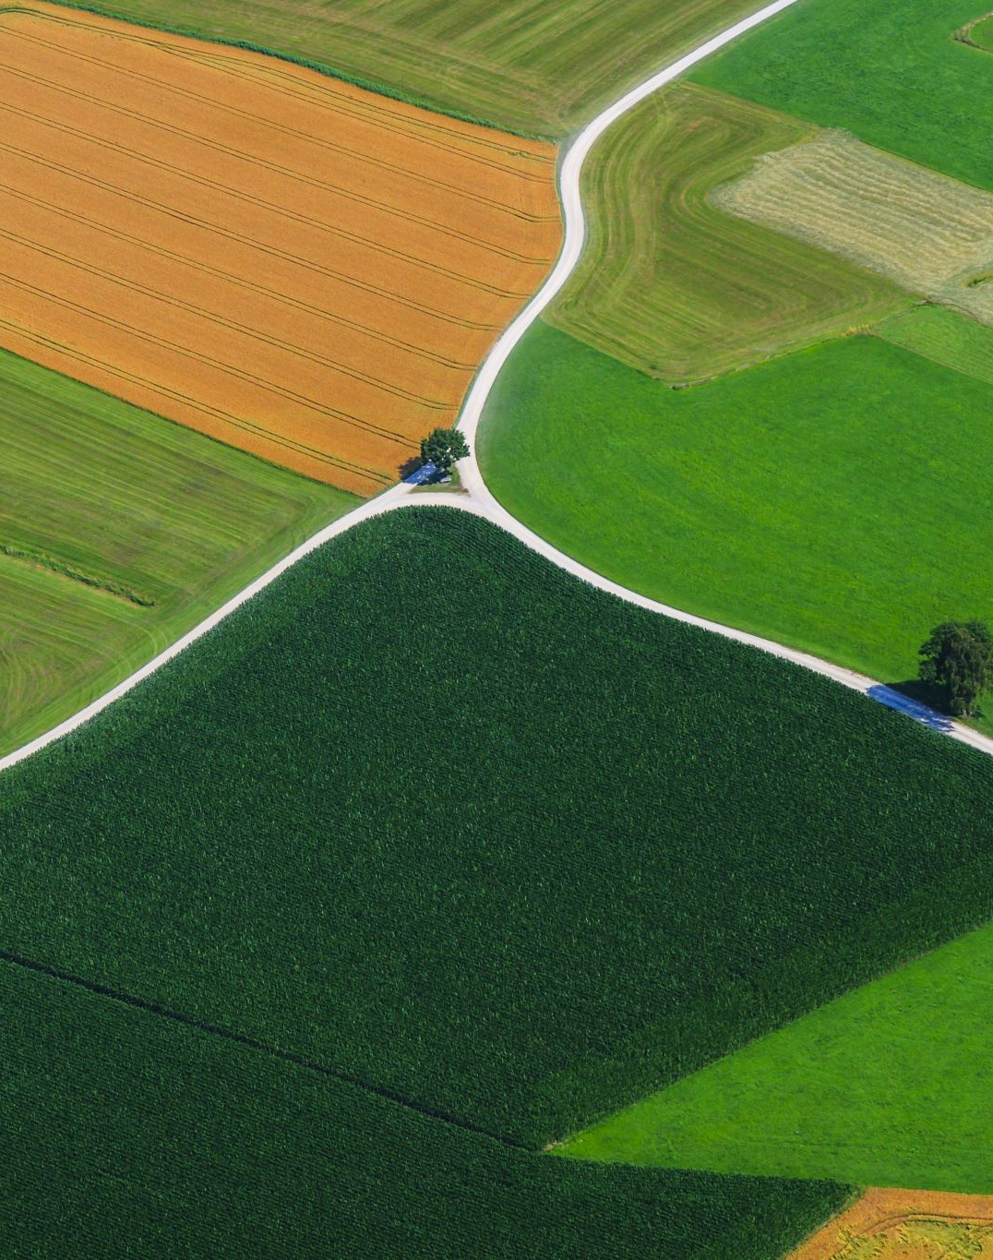
Agenda
Crop Type Classification
Business Case
Field Feature Engineering
Decision Tree
Support Vector Machine
k-NN Classification
Accuracy Comparisons
Business Application
AI & ML Next Steps

Slide 3
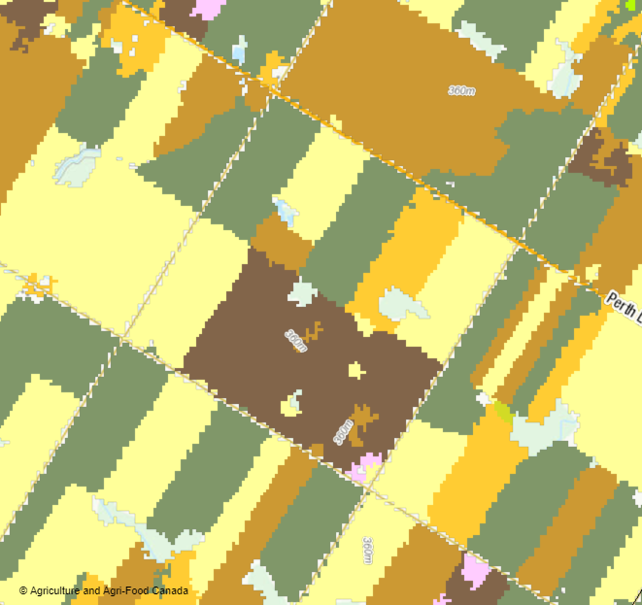
Crop Type Classification
Established Remote Sensing Procedure
‘Classic’ method pixel-by-pixel
Multi-date image stacks
Typical accuracies 80-90%
Vegetation Indices
Smoothing operations post hoc

Slide 4
Business Case
We want to know how much of which crop is growing where. Why?
Commodities market needs timely and accurate estimates
Shipping logistics require timely and accurate forecasts
Midstream terminals need to allocate space
Crop Insurance wants to know overall exposure
Individual farmers’ cropping decisions
Business Requirements
Highest accuracy at lowest cost
Near real-time data & classification
Simple, easy-to-integrate data product

Slide 5
Field-Bounded Feature Engineering
What if we know the field boundaries a priori?
Aggregate pixel features and statistics
Classification applied to whole and discrete field
Spurious non-agricultural features ignored

Slide 6
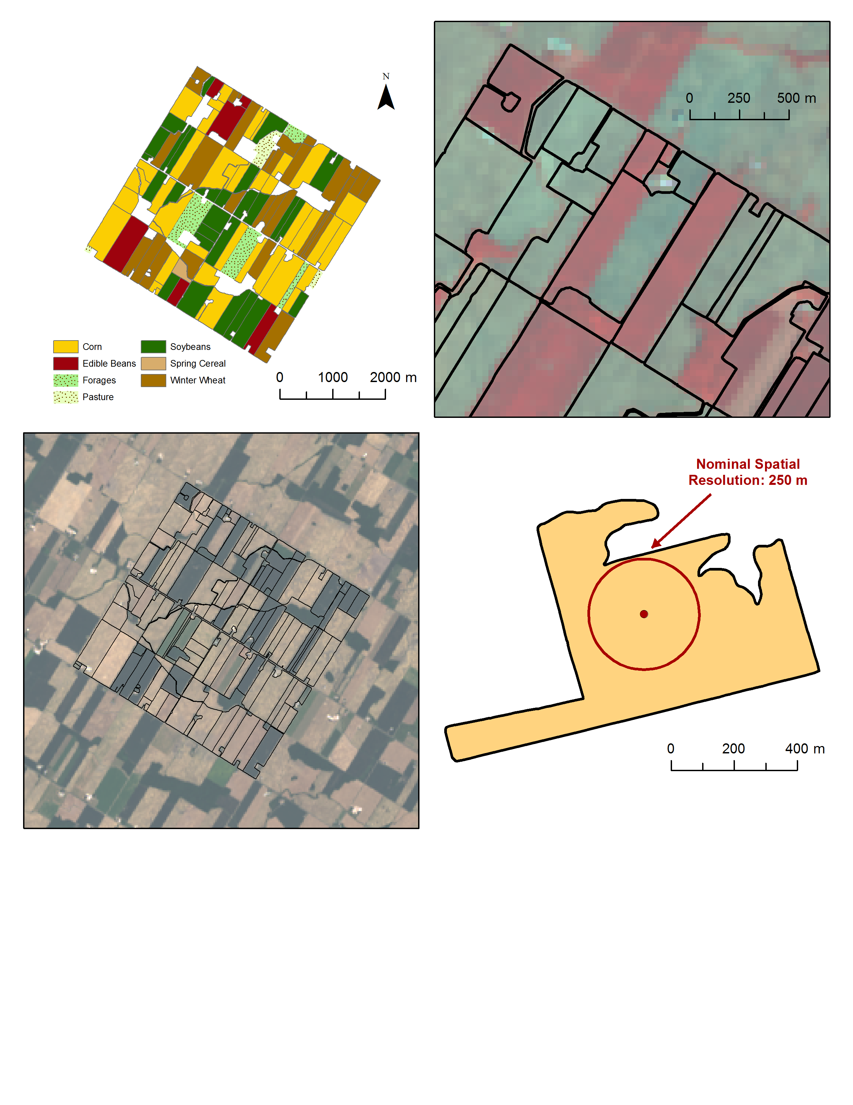
Field-Bounded Feature Engineering
What if we know the field boundaries a priori?
Aggregate pixel features and statistics
Classification applied to whole and discrete field
Spurious non-agricultural features ignored

Slide 7
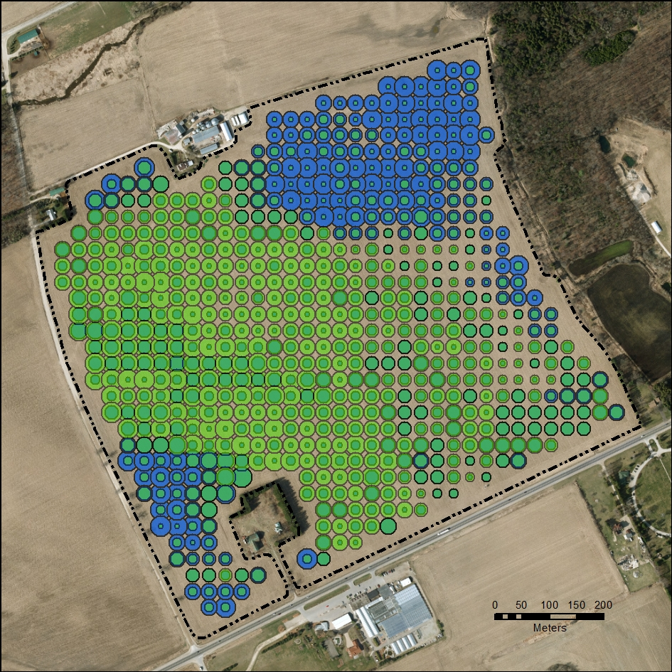
Field-Bounded Feature Engineering
Soybean Field 13
43° 30’ 01”N/ 80° 23’ 47” W
What if we know the field boundaries a priori?
Aggregate pixel features and statistics
Classification applied to whole and discrete field
Spurious non-agricultural features ignored
NDVI & Tasseled Cap Wetness

Slide 8
Field-Bounded Feature Engineering
What if we know the field boundaries a priori?
Aggregate pixel features and statistics
Classification applied to whole and discrete field
Spurious non-agricultural features ignored

Slide 9
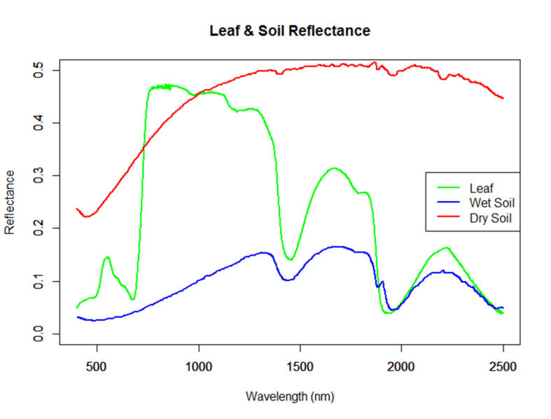
Data and Statistical Background
Landsat 8 OLI – 7 Bands – 30 m resolution
Normalized Difference Vegetation Index (NDVI)
Median Field Values
NDVI Skewness
Bands | Wavelength (micrometers)
Band 1 - Aerosols | 0.43-0.45
Band 2 - Blue | 0.45-0.51
Band 3 - Green | 0.53-0.59
Band 4 - Red | 0.64-0.67
Band 5 - Near Infrared | 0.85-0.88
Band 6 - SWIR 1 | 1.57-1.65
Band 7 - SWIR 2 | 2.11-2.29
https://www.usgs.gov/faqs/what-are-band-designations-landsat-satellites

Slide 10
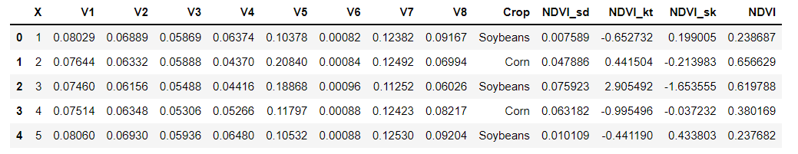
Landsat Data: September 24, 2013
Atmospherically-corrected Reflectance for each band
Median Value extracted at each of 928 fields (>15 ha)
NDVI: (V4+V5)/(V5-V4)
Standard Deviation
Kurtosis
Skewness

Slide 11
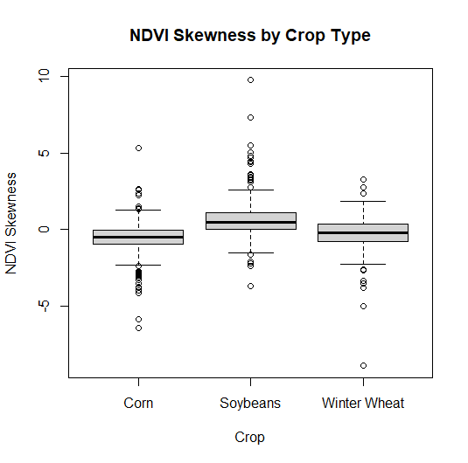
NDVI Skewness
Testing a field-aggregated statistic in classification
ANOVA reveals difference in group means (p < .001)
Tukey’s HSD agrees (p < .05 all pairs)
Spatial autocorrelation not accounted

Slide 12
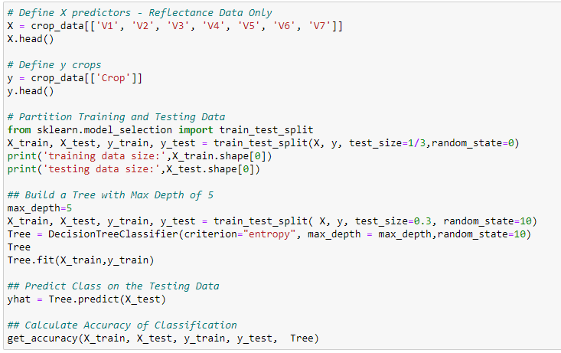
Decision Tree
Trees of Max Depth: 5 fit to each combination of inputs
Bagging with Max Depth 5
Random Forest to 100 estimators

Slide 13
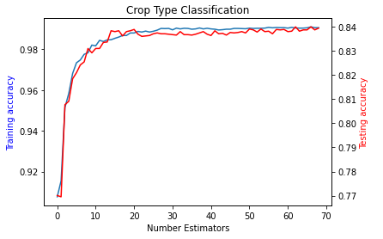
Decision Tree
Trees of Max Depth: 5 fit to each combination of inputs
Bagging with Max Depth 5
Random Forest to 100 estimators

Slide 14
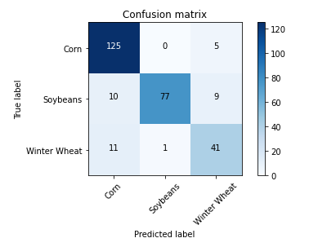
Decision Tree
Trees of Max Depth: 5 fit to each combination of inputs
Bagging with Max Depth 5
Random Forest to 100 estimators

Slide 15
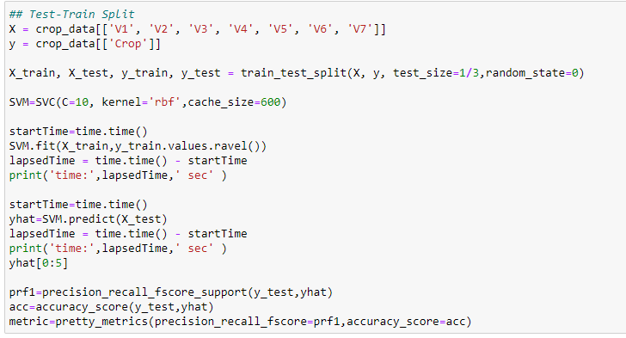
Support Vector Machine
Grid Search raising errors
‘Manual’ search for C: 10

Slide 16
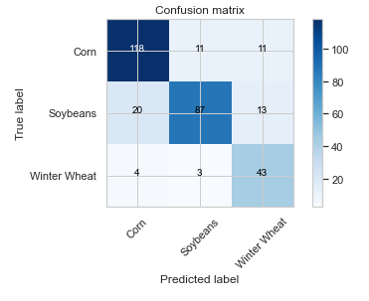
Support Vector Machine
Grid Search raising errors
‘Manual’ search for C: 10

Slide 17
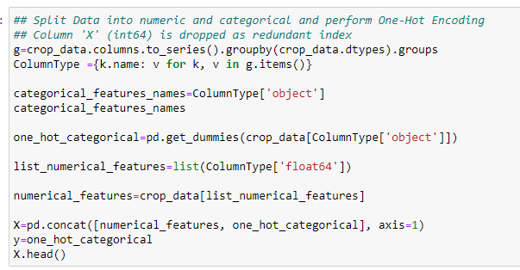
k-Nearest Neighbours
One-hot encoding
Grid Search raising errors
‘Manual’ search for k: 3

Slide 18
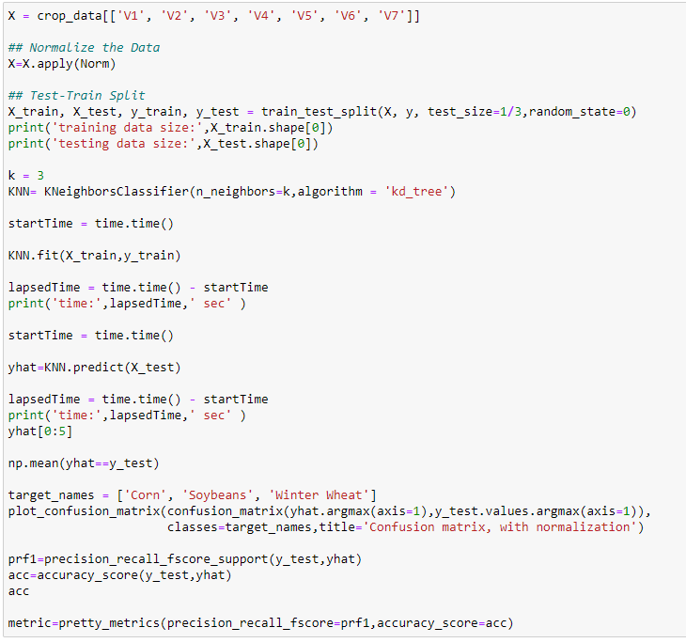
k-Nearest Neighbours
One-hot encoding
Grid Search raising errors
‘Manual’ search for k: 3

Slide 19
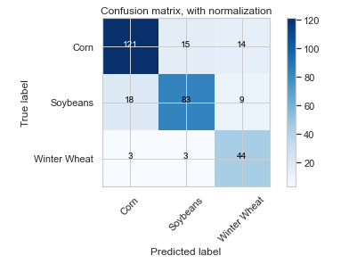
k-Nearest Neighbours
One-hot encoding
Grid Search raising errors
‘Manual’ search for k: 3

Slide 20
Accuracy Comparisons
Predictors | DT | SVM | k-NN
7 Bands | 0.831 | 0.800 | 0.790
5 Bands + NDVI | 0.817 | 0.790 | 0.784
5 Bands + NDVI + Skew | 0.810 | 0.661 | 0.768
NDVI + Skew | 0.760 | 0.661 | 0.620
Bagging (7 Bands) | 0.838 | - | -
Random Forest (7 Bands) | 0.871 | - | -

Slide 21
Confusion Matrices
Random Forest
SVM
k-NN

Slide 22
Business Application
Demonstrated 80%+ accuracy with single Landsat image
Expected improvement with retrospective image stacks
Expected improvement with feature engineering
“Quick & Easy” with the right ingredients
Recalling all features are agriculture: accuracy in acreage estimations
Decision Trees prone to overfitting
Use partner data for robust training set e.g. Crop Insurance

Slide 23
AI & ML Next Steps
Soybean Field 13
43° 30’ 01”N/ 80° 23’ 47” W
Where field boundaries are not available, use imagery to detect and extract
Test with multiple dates of imagery
Test further within-field statistics and features
Explore combinations of features as predictors
Relate vegetation index features to crop health
NDVI & Tasseled Cap Wetness

